Slide 1
Meeting #4 Meeting #3 (continued)
Quality control (continued)

Slide 2
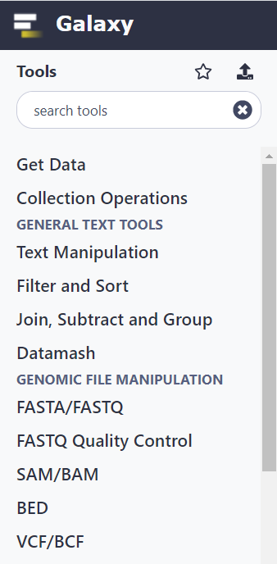
Downloading fastq from SRA and quality control (QC)
https://www.ncbi.nlm.nih.gov/sra
Download the whole genome sequencing data from baker’s yeast (Saccharomyces cerevisiae):
https://www.ncbi.nlm.nih.gov/sra/SRX8430549[accn]
Use SRA toolkit to download the run number SRR11881059:
Instructions to install:
https://github.com/ncbi/sra-tools/wiki/02.-Installing-SRA-Toolkit
A test:
fastq-dump --stdout SRR11881059 | head -n 8
Downlaod and split the paired-end reads simultanously (--split-files), skip technical reads (--skip-technical), remove adapter sequences from reads (--clip) and gzip the output:
> fastq-dump \
--gzip SRR11881059 \
--skip-technical \
--dumpbase \
--split-files \
--clip \
Check the quality of the samples with FASTQC:
> mkdir fastqc
> fastqc fastq/* -o fastqc
Galaxy is an alternative to command line tools, if you only need to run a limited amount of jobs and don’t care about computational resources. It serves perfectly for educational purposes.
Visit https://usegalaxy.org/
To register and get started.
To download run SRR11881059:
Get Data -> Download and Extract Reads in FASTA/Q format from NCBI SRA
To run FASTQC:
GENOMIC FILE MANIPULATION -> FASTQ Quality Control -> FastQC

Slide 3
Meeting #4
Genome assembly
Current challenges in genome assembly

Slide 4
Genome assembly
The present and future of de novo whole-genome assembly
Jang-il Sohn and Jin-Wu Nam
Briefings in Bioinformatics, 19(1), 2018, 23–40
doi: 10.1093/bib/bbw096

Slide 5
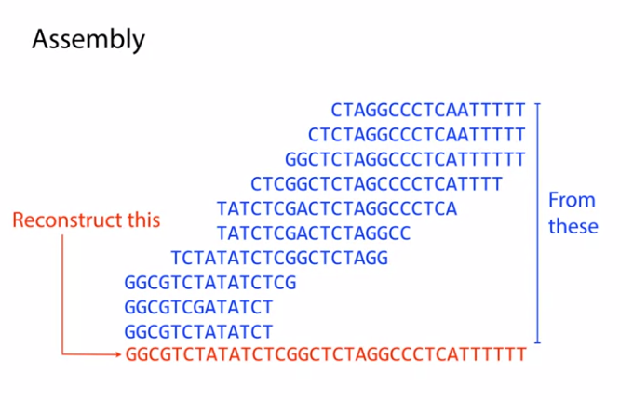
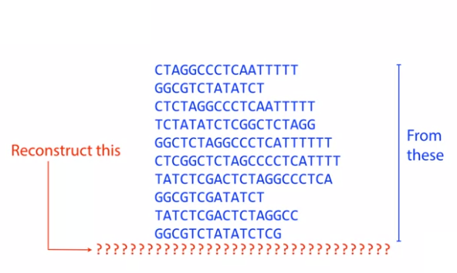
The assembly problem

Slide 6
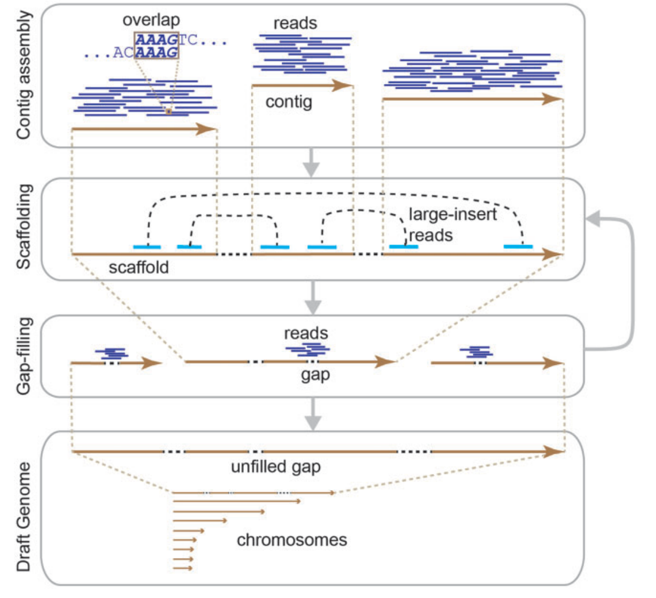
General workflow of genome assembly
General workflow of the de novo assembly of a whole genome.
By overlapping reads, contigs are assembled from short reads before scaffolding by large-insert reads, and the remaining gaps are filled. The scaffolding and gap-filling steps can be iteratively performed until no contigs are scaffolded or no additional gaps are resolved before completion. Through this procedure, a draft genome consisting of chromosomes is built. Some unfilled gaps may remain in the draft genome.
Contig = consensus sequence without gaps
Scaffolding = contigs are connected by large-insert paired reads or large DNA fragments.
If gaps remain between contigs, those are filled with other independent reads.
The scaffolding may then repeat iteratively along with gap filling.

Slide 7
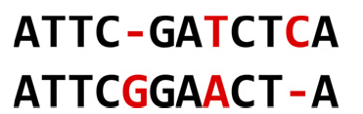
Comparing sequences of the same length
Solve this Hamming distance problem:
Counting Point Mutations
http://rosalind.info/problems/hamm/
Similarity score
The number of matching bases
Hamming distance (dissimilarity score)
The number of non-matching bases
Edit distance
The number of edit operations (substitutions, deletions, insertions) needed to turn one sequence into the other.
Alignment algorithms

Slide 8
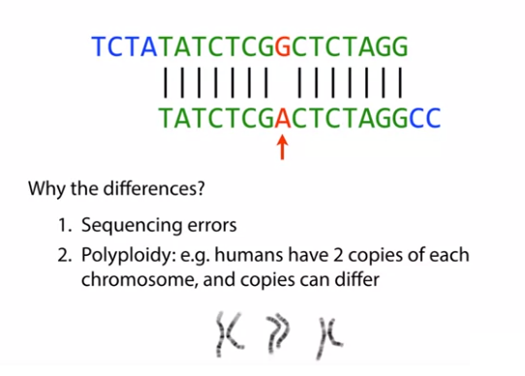
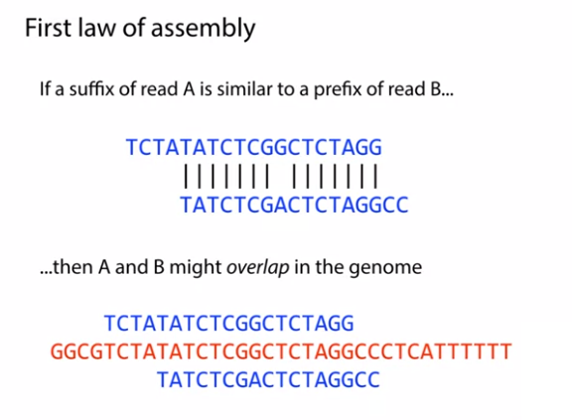
The first low of assembly

Slide 9
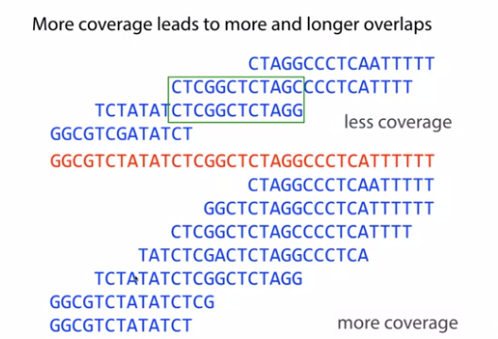
The second low of assembly

Slide 10
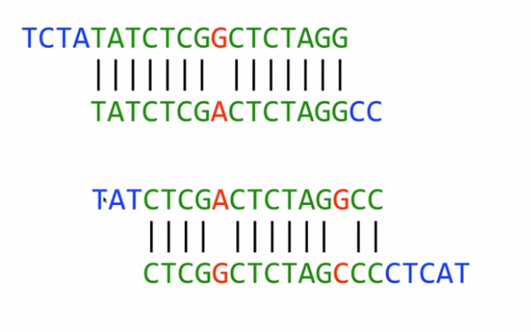
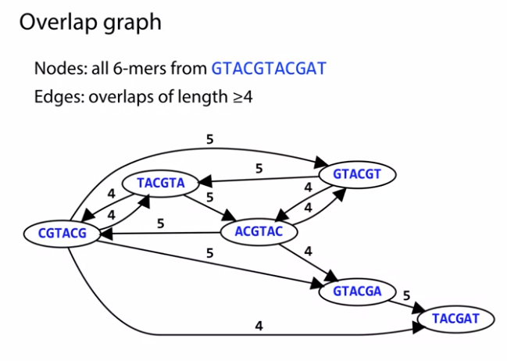
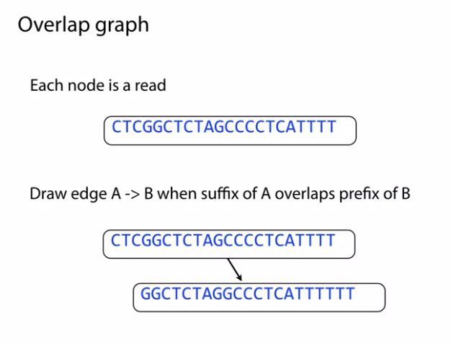
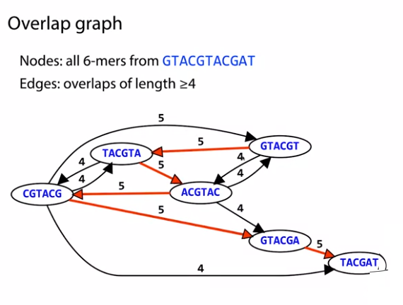
Overlap layout consensus (OLC) approach

Slide 11
Overlap graphs
http://rosalind.info/problems/grph/
Problem
A graph whose nodes have all been labeled can be represented by an adjacency list, in which each row of the list contains the two node labels corresponding to a unique edge.
A directed graph (or digraph) is a graph containing directed edges, each of which has an orientation. That is, a directed edge is represented by an arrow instead of a line segment; the starting and ending nodes of an edge form its tail and head, respectively. The directed edge with tail v and head w is represented by (v,w) (but not by (w,v)). A directed loop is a directed edge of the form (v,v).
For a collection of strings and a positive integer k, the overlap graph for the strings is a directed graph Ok in which each string is represented by a node, and string s is connected to string t with a directed edge when there is a length k suffix of s that matches a length k prefix of t, as long as s≠t; we demand s≠t to prevent directed loops in the overlap graph (although directed cycles may be present).
Given:A collection of DNA strings in FASTA format having total length at most 10 kbp.
Return: The adjacency list corresponding to O3. You may return edges in any order.
Sample Dataset
>Rosalind_0498
AAATAAA
>Rosalind_2391
AAATTTT
>Rosalind_2323
TTTTCCC
>Rosalind_0442
AAATCCC
>Rosalind_5013
GGGTGGG
Sample Output
Rosalind_0498 Rosalind_2391
Rosalind_0498 Rosalind_0442
Rosalind_2391 Rosalind_2323

Slide 12
Genome Assembly as Shortest Superstring
http://rosalind.info/problems/long/
Problem
For a collection of strings, a larger string containing every one of the smaller strings as a substring is called a superstring.
By the assumption of parsimony, a shortest possible superstring over a collection of reads serves as a candidate chromosome.
Given: At most 50 DNA strings of approximately equal length, not exceeding 1 kbp, in FASTA format (which represent reads deriving from the same strand of a single linear chromosome).
The dataset is guaranteed to satisfy the following condition: there exists a unique way to reconstruct the entire chromosome from these reads by gluing together pairs of reads that overlap by more than half their length.
Return: A shortest superstring containing all the given strings (thus corresponding to a reconstructed chromosome).
Sample Dataset
>Rosalind_56
ATTAGACCTG
>Rosalind_57
CCTGCCGGAA
>Rosalind_58
AGACCTGCCG
>Rosalind_59
GCCGGAATAC
Sample Output
ATTAGACCTGCCGGAATAC

Slide 13
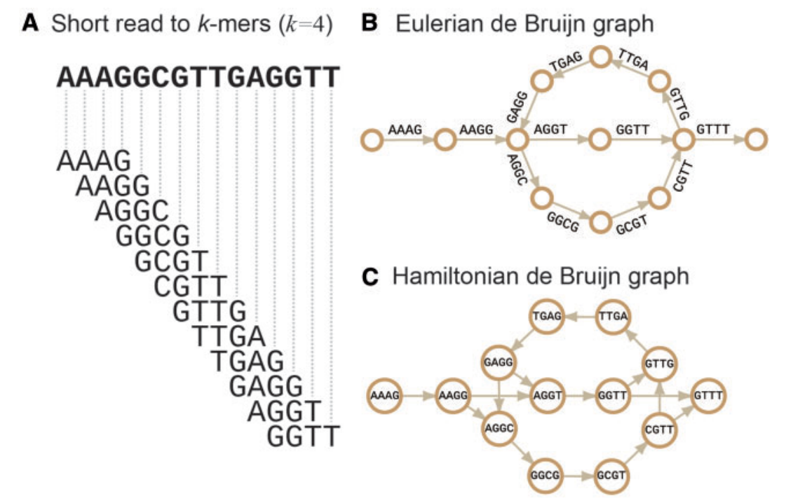
The de Brujin graph approach
A. In the de Bruijn graph approach, short reads are split into short k-mers before the de Bruijn graphs are built.
B-C. In the Hamiltonian approach (similar to OLC), the k-mers are the nodes, whereas they are the edges in the Eulerian approach. The k-mers are connected to neighbors by overlapping prefix and suffix (k-1)-mers.
The sequences are assembled by finding
Hamiltonian paths that traverse all nodes, each of which is visited only once.
The Eulerian de Bruijn graph approach is able to solve the complicated graph problem by finding the Eulerian paths that traverse all edges, each of which is visited only once.
All reads are split into (L - k + 1) k-mers, where L is the read length, and k is the size of the k-mer. The k-mers are connected by over-lapping prefix and suffix (k-1)-mers.

Slide 14
Challenges in de novo short read assembly
Correction of sequencing errors -> missassembly
Illumina platforms generally produce short reads with <1% random sequencing errors, and the errors tend to be accumulated in the 3’ part of reads
The main challenge is error identification is distinguishing them from heterozygous alleles.
Solution: k-mer counting (low-depth k-mer assumed erroneous), suffix trees (low frequency branches), multiple siequence alignment
Uneven read depth -> gaps
Results from PCR, cloning, extreme GC bias, sequencing errors and copy number variations
Solution = optimal k, read depth methods
Topological complexity of repetitive elements
Solution = long reads
Algorithmic complexity that requires a high computation cost
the assembly of large genomes, such as mammalian genomes, typically takes from several days to weeks and requires over tens to hundreds of gigabytes (GB) of peak RAM memory,
http://rosalind.info/problems/corr/

Slide 15
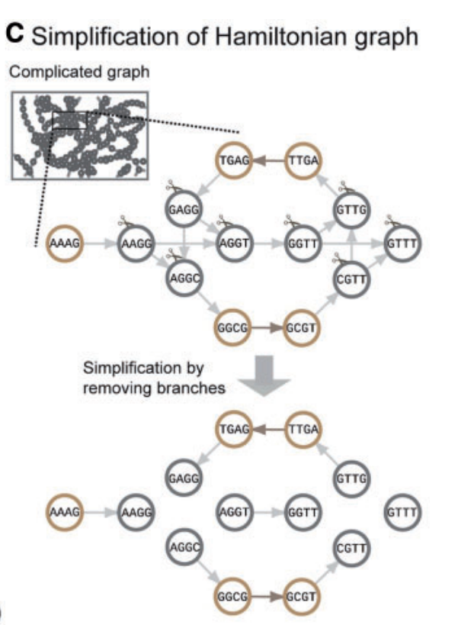
Computational complexity
The computational complexity to find the Hamiltonian paths is O(mx2^{n}), where m is the total number of nodes, and n is the number of branching nodes.
- Solution: debranching (repeat removal, other -> short contigs)
The Eulerian path problem can be solved without simplification in polynomial time, O(n²)
Paradoxically, most of the assemblers that implement the Hamiltonian de Bruijn graph, including, are much faster than the assemblers that implement the Eulerian de Bruijn graph, due to path simplification. The trade-off between speed and accuracy should therefor be made.

Slide 16
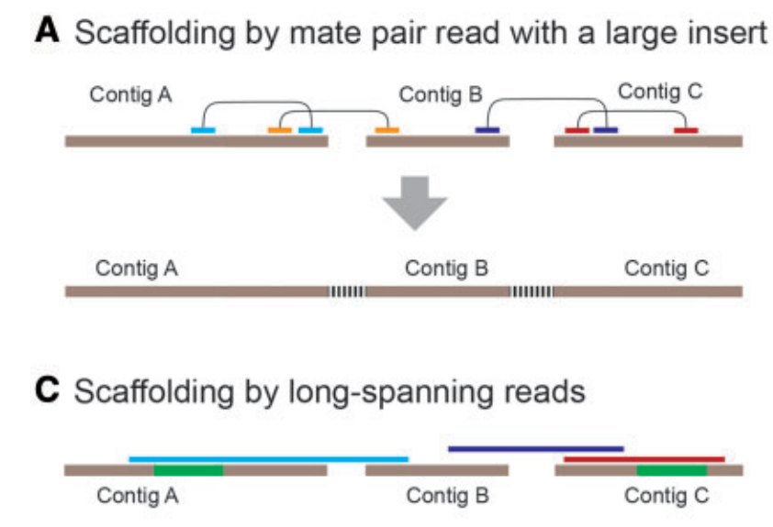
Approaches to scaffolding
Hybrid approaches combine long-read and short read sequencing for better scaffolding and higher accuracy

Slide 17
Genome annotation
Finding genes in an unknown DNA sequence

Slide 18
Finding genes in a DNA sequence
Ab initio (from scratch)
For protein coding genes: Rule based - start (commonly ATG) and stop codons(TAA/TAG/TGA) and some nucleotide context around them, splice sites, etc. Should check in 6 frames
For all genes: Statistical information (based on a priori training). E.g. codon bias (for protein coding genes), nucleotide composition
Based on previous knowledge
Homology (similar sequences between different organisms)
Similarity to known genes
Translating RNA into Protein
http://rosalind.info/problems/prot/
Finding a motif in DNA
http://rosalind.info/problems/subs/

Slide 19
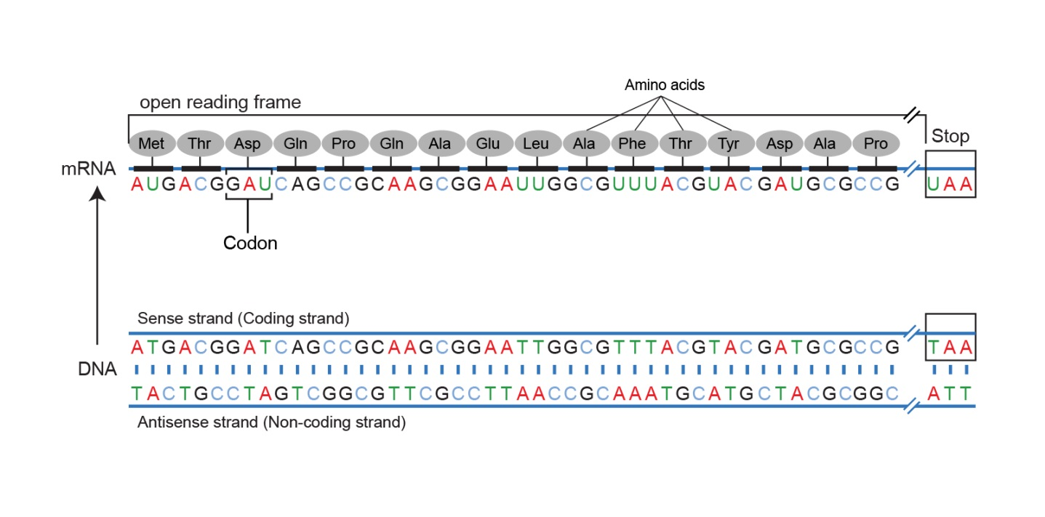
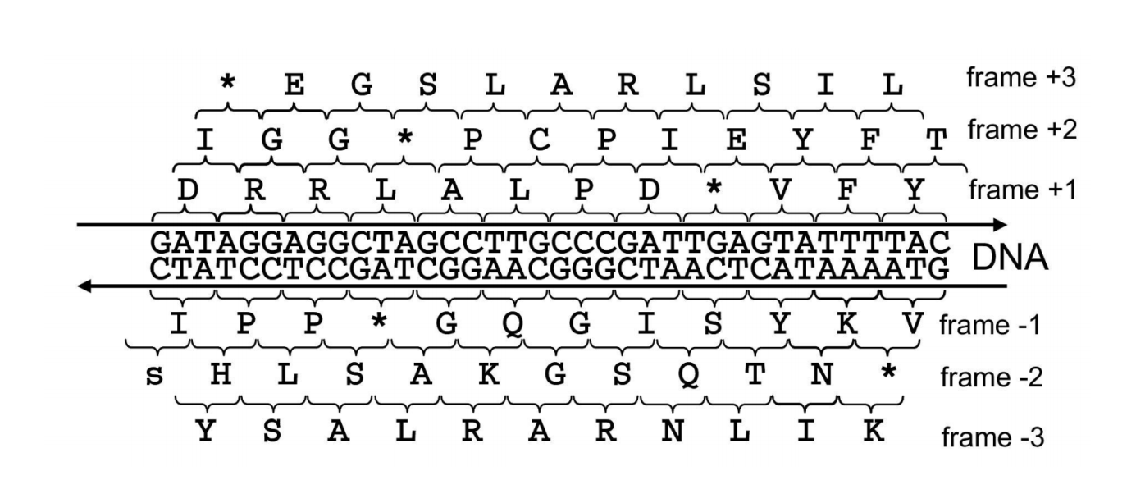
Open reading frames (ORFs)
Open reading frames (ORFEither strand of a DNA double helix can serve as the coding strand for RNA transcription. Hence, a given DNA string implies six total reading frames, or ways in which the same region of DNA can be translated into amino acids: three reading frames result from reading the string itself, whereas three more result from reading its reverse complement. An open reading frame (ORF) is one which starts from the start codon and ends by stop codon, without any other stop codons in between. Thus, a candidate protein string is derived by translating an open reading frame into amino acids until a stop codon is reached.)
The standard genetic code:
http://www.bioinformatics.org/JaMBW/2/3/TranslationTables.html#SG1
Finding Genes with ORFs
http://rosalind.info/problems/orfr/
Open Reading Frames
http://rosalind.info/problems/orf/
Protein Translation
http://rosalind.info/problems/orf/
IGV image of stop codons

Slide 20
A unified catalog of 204,938 reference genomes from the human gut microbiome
Nature Biotechnology (2020)
DOI: 10.1038/s41587-020-0603-3

Slide 21
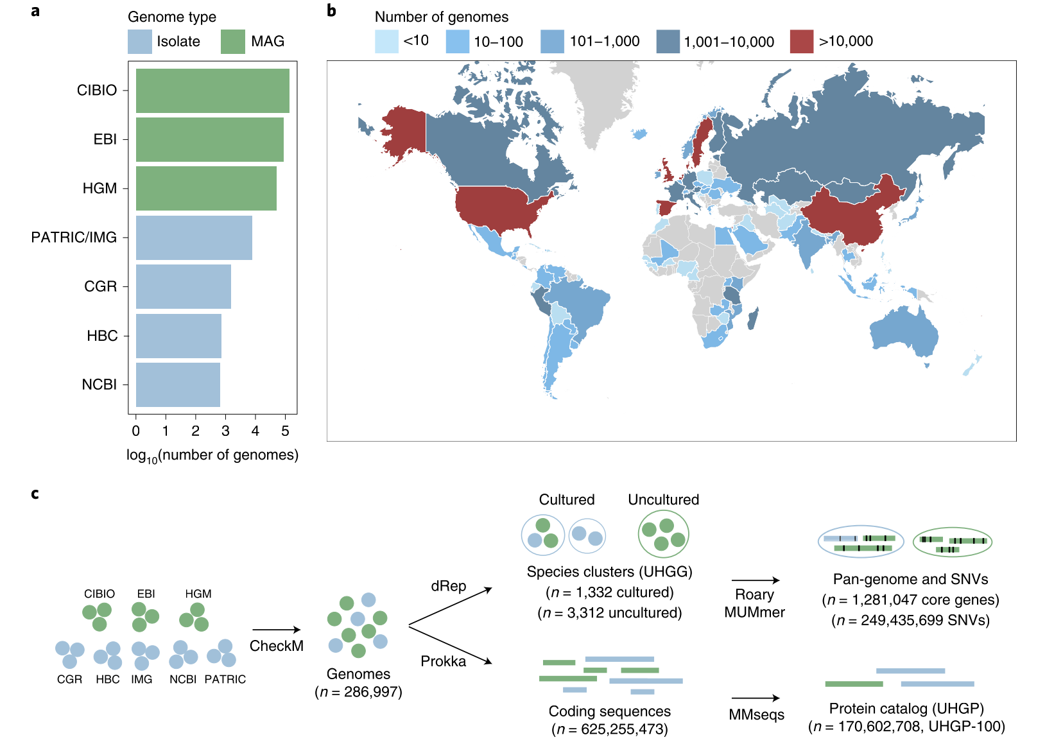
The unified sequence catalog of the human gut microbiome
a, Number of gut genomes for each study set used to generate the sequence catalogs, colored according to whether they represent isolate genomes or metagenome-assembled genomes (MAG)s. b, Geographic distribution of the number of genomes retrieved per country.
c, Overview of the methods used to generate the genome (UHGG, Unified Human Gastrointestinal Genome) and protein sequence (UHGP) catalogs. Genomes retrieved from public datasets first underwent quality control by CheckM. Filtered genomes were clustered at an estimated species level (95% ANI), and their intraspecies diversity was assessed (genes from conspecific genomes were clustered at 90% protein identity). In parallel, a nonredundant protein catalog was generated from all coding sequences of the 286,997 genomes at 100% (UHGP-100, n = 170,602,708), 95% (UHGP-95, n = 20,239,340), 90% (UHGP-90, n = 13,907,849) and 50% (UHGP-50, n = 4,735,546) protein identity.
4,644 inferred prokaryotic species
573 high quality genomes
60% could not be assigned to existing species
71% lack cultured representative

Slide 22
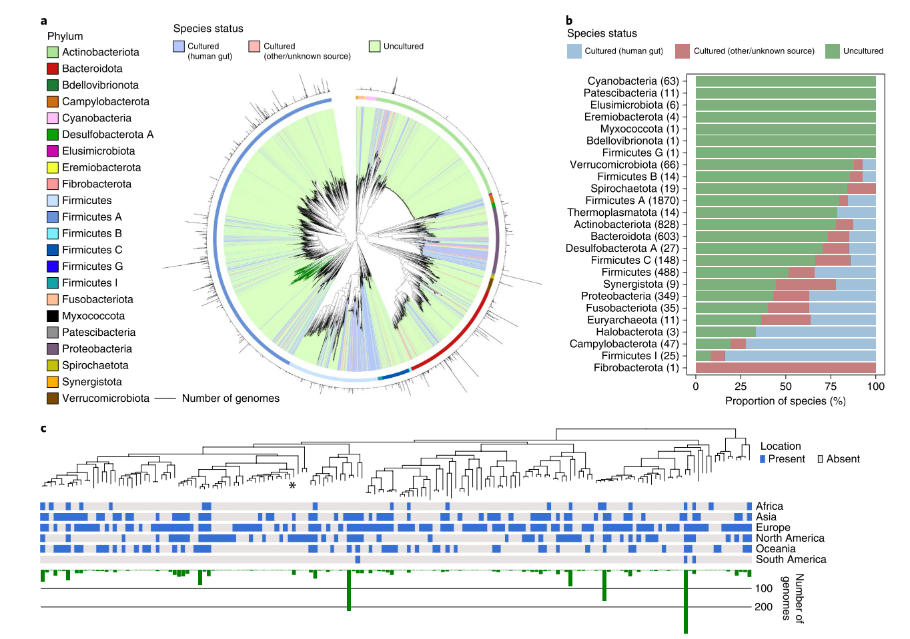
Uncultured species are predominant among human gut phyla.
a, Maximum-likelihood phylogenetic tree of the 4,616 bacterial species detected in the human gut. Clades are colored by the cultured status of species, with outer circles depicting the GTDB phylum annotation. Bar graphs in the outermost layer indicate the number of genomes from each species. The order Comantemales ord. nov. is highlighted with dark green branches.
b, Proportion of species within the 25 prokaryotic phyla detected according to cultured status. Numbers in parentheses represent the total number of species in the corresponding phylum.
c, Phylogenetic tree of species belonging to the order Comantemales ord. nov. (phylum Firmicutes A), the largest phylogenetic group exclusively represented by uncultured species. The geographic distribution of each species and the number of genomes recovered are represented below the tree. The species previously classified as Candidatus ‘Borkfalki ceftriaxensis’ is indicated with an asterisk.

Slide 23
Problems from ISBM 2020
the 28th Annual Conference on Intelligent Systems for Molecular Biology, July 13–16, 2020

Slide 24
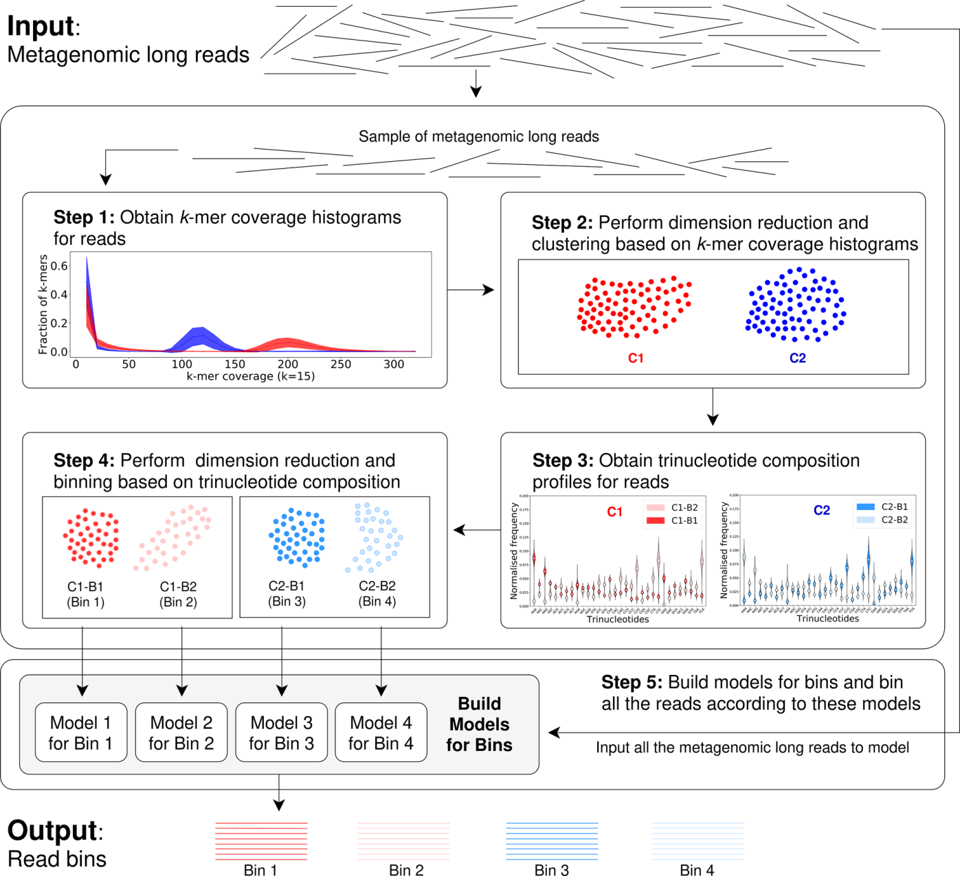
MetaBCC-LR: metagenomics binning by coverage and composition for long reads https://doi.org/10.1093/bioinformatics/btaa441
design MetaBCC-LR, a scalable reference-free binning tool to bin metagenomic long reads. MetaBCC-LR uses discriminatory features, that capture species abundance and composition information, for finding the number of bins and developing a statistical model for each bin. This is accomplished by using just a sample of the input reads, enabling MetaBCC-LR to efficiently handle large datasets.
Typically, assemblers erroneously assume uniform coverages and low abundance species tend to be ignored—that can be ameliorated by binning reads before assembly.

Slide 25
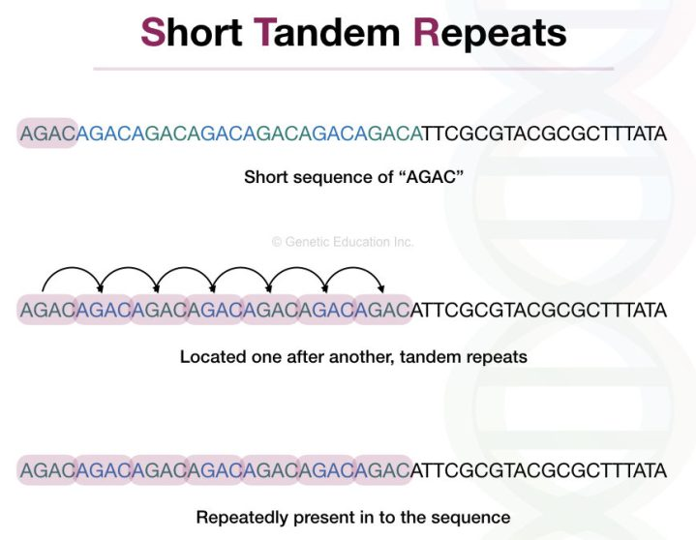
TandemTools: mapping long reads and assessing/improving assembly quality in extra-long tandem repeats
Tandem repeats are formed by multiple consecutive nearly identical sequences that are often generated by unequal crossover.
We distinguish between extensively studied short tandem repeats and extra-long tandem repeats (ETRs) that range in length from tens of thousands to millions of nucleotides. Centromeric and pericentromeric regions contain some of the longest ETRs that account for ∼3% of the human genome and span megabase-long regions. Centromeres and pericentromeres represent the ‘dark matter’ of the human genome that evaded all attempts to sequence until recently and are the largest gaps in the reference human genome. The goal of the telomere-to-telomere (T2T) consortium is to generate a complete assembly of the human genome, including all centromeres and pericentromeres. This effort recently resulted in assemblies of chromosomes X and Y but centromeres in other chromosomes are waiting to be assembled.
Problems:
Repeats
Absence of ground truth benchmarking.

Slide 26
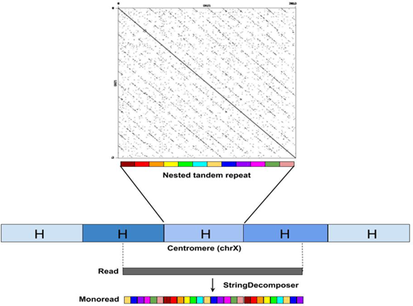
The string decomposition problem and its applications to centromere analysis and assembly
Recent attempts to assemble extra-long tandem repeats (such as centromeres) faced the challenge of translating long error-prone reads from the nucleotide alphabet into the alphabet of repeat units. Human centromeres represent a particularly complex type of high-order repeats (HORs) formed by chromosome-specific monomers. Given a set of all human monomers, translating a read from a centromere into the monomer alphabet is modeled as the String Decomposition Problem. The accurate translation of reads into the monomer alphabet turns the notoriously difficult problem of assembling centromeres from reads (in the nucleotide alphabet) into a more tractable problem of assembling centromeres from translated reads.
We describe a StringDecomposer (SD) algorithm for solving this problem

Slide 27
Thank you
Next topics:
Alignment
variant calling

